Slide 1
Rules and Prototypes
Mack 2023

Slide 2
Learning Objectives
Paper prototypes are fast, cheap tools that game designers use to emulate the game experience.
Certain game mechanics are easier to prototype than others.
While paper prototyping, game designers must use creative, alternative approaches to emulate the game experience.
Students will understand the importance of clear and concise rules in board game design.
Students will learn strategies for writing clear and concise rules for a board game.
Students will practice writing clear and concise rules for a board game.

Slide 3
Games are rules.
Rules are games.
Yes? No? Explain.

Slide 4
Game designers create rules.
Good games have complete rules.

Slide 5
Writing rules is another way to develop your prototype.
Writing rules helps define your game.

Slide 6
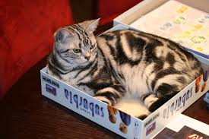

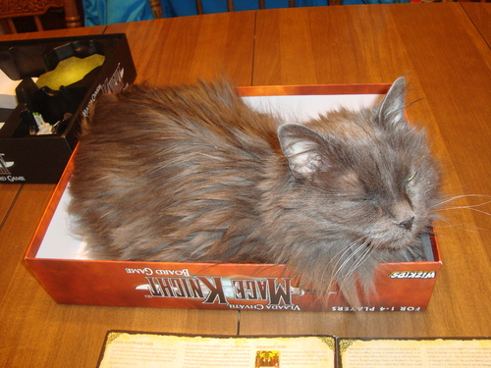
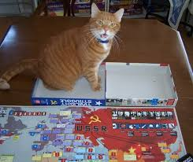
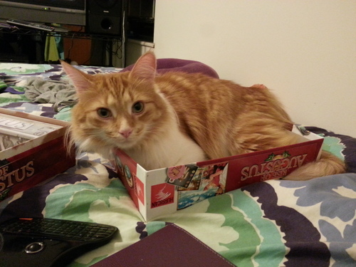
You Don’t Come in the Box!
You have to write a rule book that explains what players have to do with hopefully no questions.

Slide 7
Two Purposes for Rules
Help new players learn how to play the game
Gives an overview and flow of the game before the specifics
Act as a reference for experienced players
Comprehensive and complete to have no unanswered questions regarding the rules
Uses subheadings to help players find information.

Slide 8
The Four* C’s of Good Rules
Clear
Consistent
Concise
Complete

Slide 9
The Four* C’s of Good Rules
Clear: The goals and decisions players may make, using the game’s resources, are clear.
There is a difference between may, must, can, etc.
“Last” may mean “previous” or “final.”
Either could mean “one or the other” or “both.”
Be sure to choose your words carefully. Life lesson.

Slide 10
The Four* C’s of Good Rules
Consistent: Use the same structure and terminology throughout the rules.
Terminology needs to be consistent.
Using two different terms for the same thing, or the same term for different things, is bound to cause confusion -- don't do that!
Define your terms at the beginning, and stick with them.

Slide 11
The Four* C’s of Good Rules
Concise: Write bluntly and directly. Be specific.
When writing rules you have to be a straightforward and clear.
The reader must understand exactly what you are talking about without question.
There is no room for interpretation in rules so word choice must be assertive as to remove all doubt.
Use second person, imperative sentences.

Slide 12
The Four* C’s of Good Rules
Complete: The written rule set contains all of the game’s rules.
Record yourself teaching the rules, then use that recording to help you write your first draft.
Think about what information players need to know--you have to put yourself in their shoes.

Slide 13
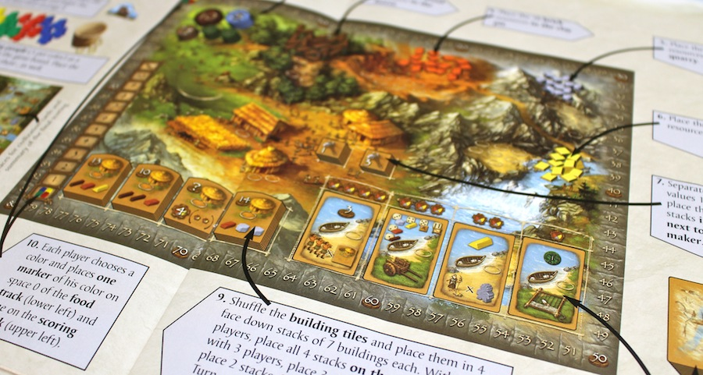
Complete: Use Diagrams!

Slide 14

Don’t assume
Players will understand what you mean or need them to do!

Slide 15
Essential Game Rule Elements

Slide 16

Title
What are you going to call the game that attracts attention and conveys the theme of the game?

Slide 17

Story
A paragraph or so long story that provides a context for the game to get players excited and to provide an overall perspective on the game.

Slide 18
Player Objectives
Explain the role players are taking on.
Explain what players will do during the game. This should cover the main actions and events of the game.
Explain how the player wins in general.

Slide 19
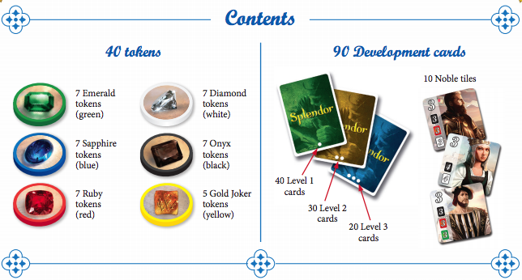
Components
A list of exact quantities of all types of game bits.

Slide 20
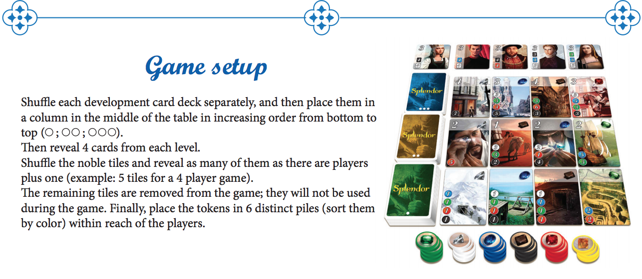
Setup
How to get the game ready for play, explained clearly with diagrams or pictures.

Slide 21
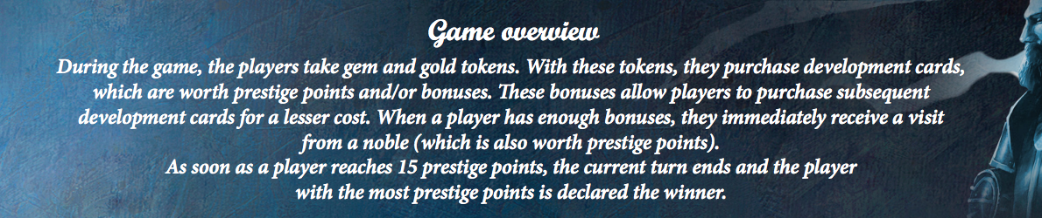
Game Play Overview
The game play overview explains the flow of gameplay (rounds, turns, phases, etc.) and summarizes what players do in each of those stages
from start to completion.

Slide 22
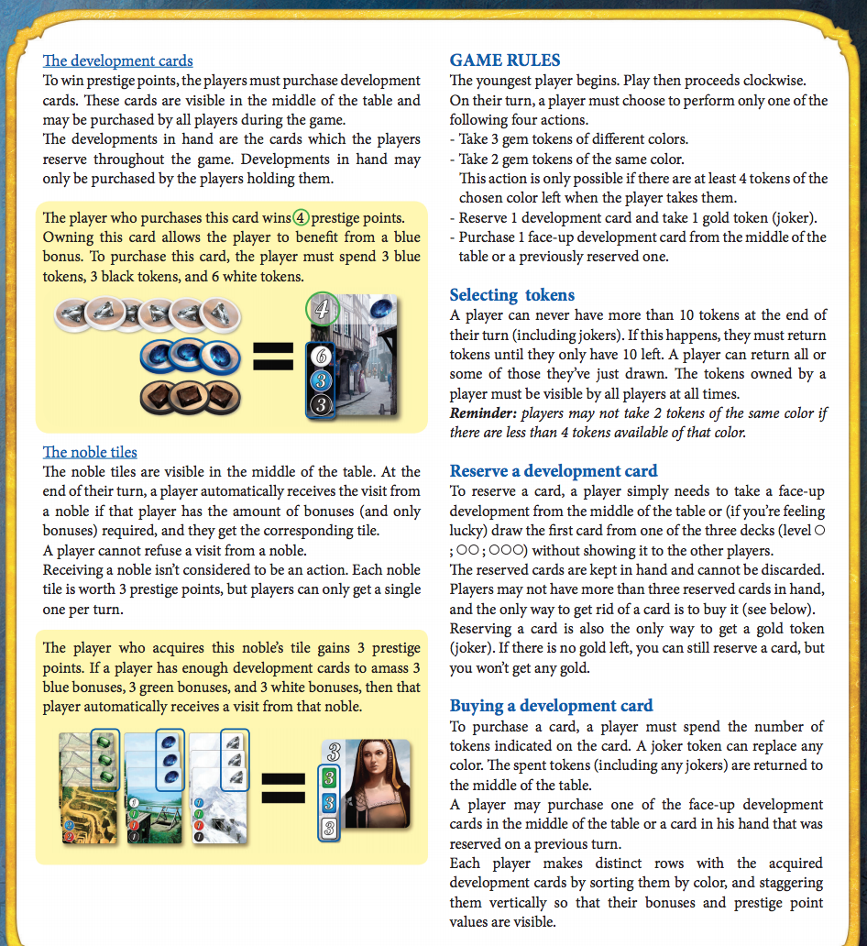
Game In Depth
Explain exactly what happens during each turn, action, round, etc., in a logical way.
You also should have sections dedicated to complicated subjects and their edge cases if necessary.
Pictures and examples are essential.

Slide 23
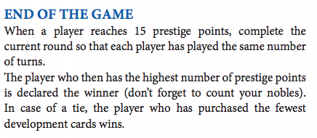
End Game Conditions
End Game Conditions explains
how the game ends
AND
how a winner is determined
AND
A tiebreaker.

Slide 24
Formatting and Writing Game Rules

Slide 25
Writing for Others
In creating a game, often the most difficult part is to write rules that are clearly understood by players.
If players don’t understand the rules, they can’t play the game.
The rules are for the players’ benefit, not yours.
YOU HAVE TO THINK HOW OTHER PEOPLE MIGHT INTERPRET YOUR RULES.

Slide 26
General Writing Guidelines
Your formatting consistency is going to assist in players understanding what you’re talking about in addition to making your rulebook easier to read.
Group things together (or put things near each other) that are connected to one another.

Slide 27
Writing as an Outline
Clearly describe all elements of the game
sequentially (in order)
logically (organized well)
pictorially (using pictures and diagrams)

Slide 28
Writing as an Outline
Be specific, step by step. Write in outline form.
Use larger font sizes to emphasize headings and subheadings.
Use color to make different elements stand out.
Use white space and lists to organize the rules, so that related rules are close together on the page.
Bullet points help clarify where one idea starts and another ends, and which ones are subsets of others.
Keep items of similar importance at the same level.
Put lesser items at a lower level.

Slide 29
Write in Second Person
You should be writing as if you’re speaking directly to the reader; using terms like “you” and “your” instead of “a player” or “their”.
It makes the rules more personal and assists in reader comprehension and retention.
If players actually see themselves playing the game when reading the rules, they’ll be more interested and involved in reading them.

Slide 30
Write in Second Person
Do Say | Don’t Say
“When you…” | “When a player…” or “The player…”
“give each player…” | “each player takes…”
“On your turn, choose…” | “On his or her turn, the active player chooses…”

Slide 31
Paper Prototype

Slide 32
Choose a Mechanics Pitch
Students will take their list of mechanics pitches and select one that they want to prototype first.
Each group chooses one of their designs to prototype.

Slide 33
Somethings to Remember
Some design evaluation criteria from the previous lessons that may assist in removing inferior pitches:
Innovation
Capacity for depth
It may be hard to create depth in a game where the outcome is purely determined by luck.
Thematic resonance/dissonance
Gameplay does/doesn’t match thematic.
Type of fun and gameplay mismatch
Developmental resources
Having one hour to create 10 character cards may be infeasible.
Complexity
A design that has high complexity (E.g., many characters, intricate abilities) may not be appropriate for the target audience (but potentially appropriate for others).

Slide 34
Make Rules > Prototype > Playtest Exercise
We have created the premise, thematic, player, goal and opposition of our game and decided on one mechanics pitch we want to prototype. We will now be creating the paper prototype and the Rules and Interaction components along the way.
By the end of this lesson, each group will have:
A playable (and unpolished) game ready for another group to playtest in the next lesson.
A single page of written rules.

Slide 35
Start with a List
List the core components of their chosen mechanics pitch

Slide 36
Make Rules
Students make an initial set of rules for their game premise and mechanics pitch.
“Make Rules” phase is used to fix problems.

Slide 37
Prototype
Students make a physical copy of their game.

Slide 38
Playtest
Students playtest their games to “find problems” and “validate assumptions.”

Slide 39
Iterate!
Students conduct at one cycle of the process and one additional one once they finish the first one!

